Slide 1
Basic Information of this Course
Electromagnetics (电磁学)
Students: Majoring in EE
Sep. 18, 2024 ~ Jan. 3, 2025 (16 weeks)
Classroom: Teaching Center Rm. 304
Lecture: Wednesday 10:15 ~ 11:55 & Friday 10:15 ~ 11:55
Lab session: SIST Bldg. #1, Rm. 1D102 EE130P: Tuesday & Wednesday 13:00 ~ 14:40 Detailed schedule will be determined later
Quiz: once every two weeks (TBD)
Discussions and Exercises: every week (TBD)
互动教学平台: 电磁学-2024秋
MOOC: https://mooc.shanghaitech.edu.cn/portal/frontCourseIndex/course.mooc?keyWord=%25E7%2594%25B5%25E7%25A3%2581%25E5%25AD%25A6

Slide 2
Information of Instructor
Xiong Wang (王雄), Associate Professor
Office: SIST Bldg. #3, Rm. 436
Office hour: Wednesday 13:00~14:40
Telephone: 20685264
Email: wangxiong@shanghaitech.edu.cn

Slide 3
Information of TAs and Lab Teacher
TAs 吕沛泽 (grader) lvpz@shanghaitech.edu.cn
郑证 (grader) zhengzheng2022@shanghaitech.edu.cn
张孝天 (grader) zhangxt2022@shanghaitech.edu.cn
田珂源 (lab) tianky2022@shanghaitech.edu.cn
蒋烨 (lab) jiangye2022@shanghaitech.edu.cn
王璇钰 (lab) wangxy22022@shanghaitech.edu.cn
Lab teacher 李娟 lijuan@shanghaitech.edu.cn

Slide 4
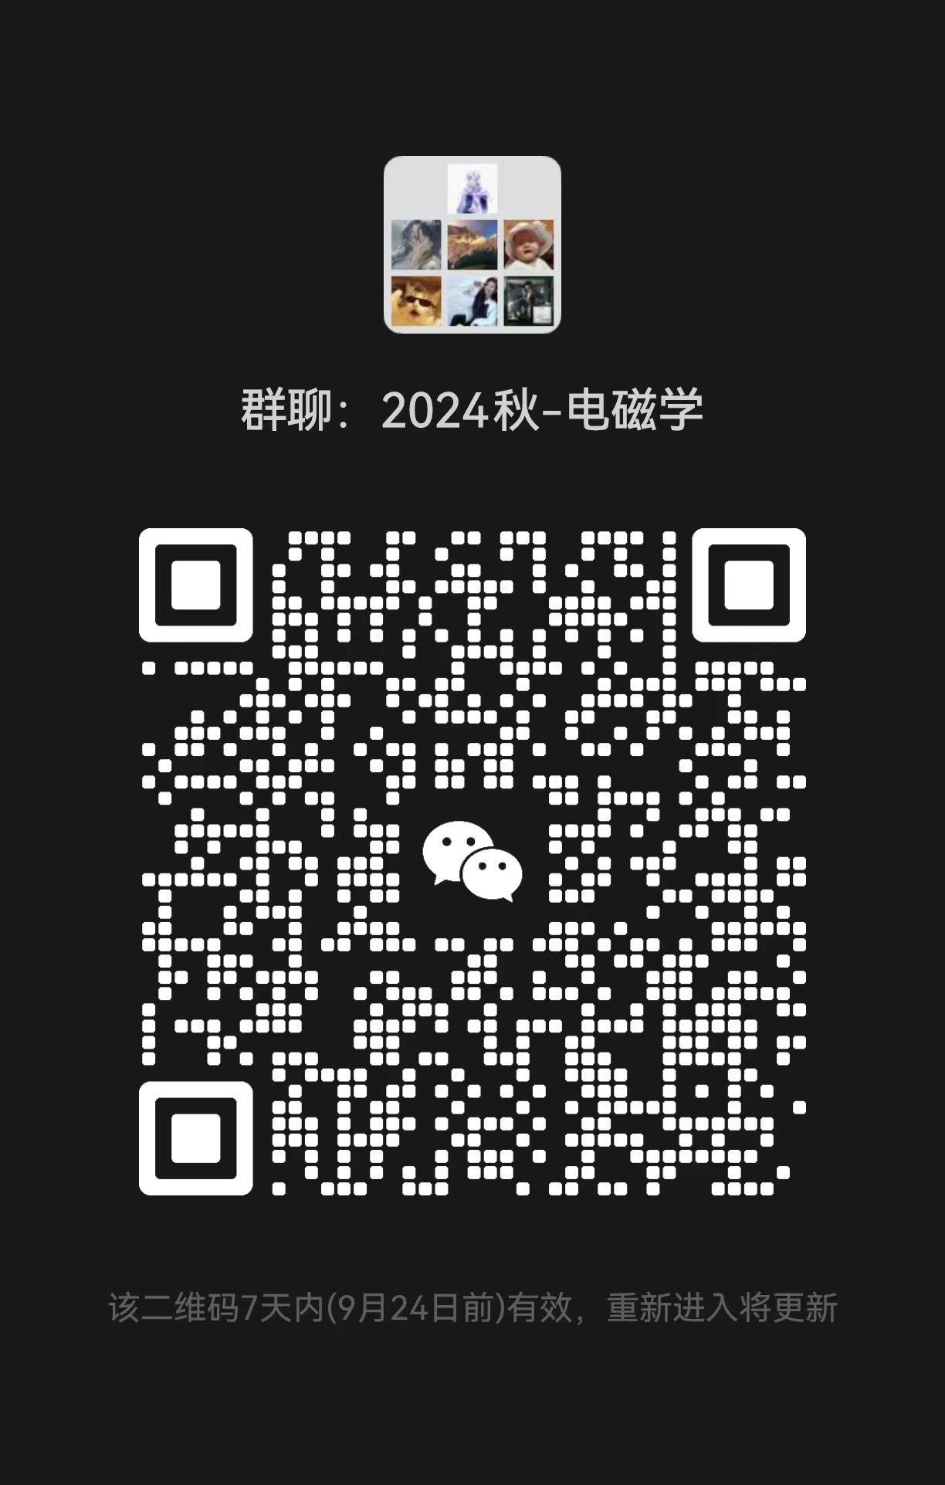
WeChat Group of the Course

Slide 5
Policies
Attitude: work hard during the entire semester
Integrity: homework, quiz, exams, lab, class projects (will be included in the final grade)
Attendance: Lecture: required. About 6-10 random roll call in class (may be added to the final score) Lab: required. 0 point for one lab session if absent. Reschedule is possible, but needs to get the teacher’s permission before the lab starts Quiz: required. Make-up is possible, but get a 30% deduction in the score and no more than two make-up during this semester. The teacher MUST be informed by email or WeChat before each quiz starts Exam: required. 0 point for one exam if absent and no make-up exam is allowed

Slide 6
Policies (cont.)
Classroom discipline: DO NOT allow playing games and watching videos on smart phones, tablets or laptops in class
Homework: assigned every two weeks (in total about 6 assignments) and collected next week in class. If you cannot finish it on time, you can turn in two days later but with a 20% deduction of the score. No homework is accepted after that. Everyone should try to work on homework problems independently. Discussion between students and searching online is allowed, but you must finally work on it by yourself even if you get some help elsewhere. Copying from each other, copying solutions, or copying the old-version homework of the junior students will be strictly punished. Please keep in mind that all the problem numbers of homework refer to those in the 7th edition of the textbook

Slide 7
Policies (cont.)
Quiz: quiz is given for about 8 times. The problems are very basic questions, calculations, or derivations based on the two lectures in the past week. All quizzes are closed-book, closed-notes, and no cheat sheet is allowed. Any kind of cheating in a quiz will lose all points for quiz in the final grade, and cheating in two quizzes will fail the class
Exams: one midterm and one final. Closed-book and closed-notes, but can take some pages (2 for midterm and 3 for final) of A4 size cheat sheet with equations, notes, figures or whatever you want to write on both sides of the papers. You need to get a calculator that can do calculations of complex numbers, exponential operation, trigonometric function and so on. Any kind of cheating in an exam will fail the class

Slide 8
Policies (cont.)
Lab session: students are grouped into teams of 2 members for each lab session. Both team members work together to finish all the required steps for an experiment and write a lab report together. Some preparation is needed for some lab sessions before doing the experiments. The equipment and accessories will be used in labs are very expensive, so very careful operation is required and you must follow the guidance of the lab teacher or TAs

Slide 9
课程规则：出勤
每节理论课都要求出勤，会随机点名6-10次，若总体出勤率不佳，则在期末总成绩的100分的基础上额外增加2分的出勤分，以总共8次点名为例，每次点名对应0.25分，出勤算0.25分，缺勤算0分
每节实验课都要求出勤，若某次实验缺勤则当次实验计0分（不影响队友的分数），如有生病等特殊情况可以缺勤并补做，但需要在实验课开始之前以邮件或微信的形式向任课老师请假
每次quiz都要求出勤，如有生病等特殊情况可以缺勤并补考，但需要在quiz开考之前以邮件或微信的形式向任课老师请假，之后的补考成绩要减去30%，每位同学的总补考次数不超过2次
期中考试（第9周周末）和期末考试（第17或18周）都要求出勤，如有生病等特殊情况缺考的，需要按照教务处的相关规定来决定是否能够补考以及如何补考（包括考试形式、题目及计分规则），凡遇到教务处规则不够明确之处，是否能够补考以及如何补考均由任课老师做最终决定。如遇参加竞赛、英语考试或其他特殊情况，请务必提前3周告知任课老师，老师会酌情考虑是否能更改考试时间，如实在不方便更改，则该次缺考不能补考

Slide 10
课程规则：纪律
课堂上不许用手机、平板或电脑玩游戏看视频，如发现将请出教室
作业共6次左右，约每两周布置一次，下周或下下周上课交（具体时间会在每次作业中写明），如不能按时交作业，可以晚两天交，但是成绩要减去20%，请不要在课上赶作业。两天之后的作业不再接收。作业允许讨论和上网查，但最终提交的版本需要自己独立完成。允许手写电子版再打印，但如遇两份雷同的电子版（其中有任何一道题雷同也算），则双方均算作弊，当此作业计0分，如发生两次作业作弊情况，该课程挂科且上报学院记入黑名单。抄袭答案或往届学生作业均视为作弊。注意：作业中出现的所有教材上的课后题均为第8版的题号，如因教材的版本号不同导致题号不一致的，均不给分，例如某次作业中有第7版的6-15和6-16两题，但第6版的6-15是第7版的6-16，第6版的6-16是另一道题，则按照第6版的题号写出的两题均不给分
Quiz共8次左右，约每两周一次，每次quiz的考核范围是前一周课堂上讲的内容，均为最基础的知识点，目的是督促同学们及时复习，以便能跟上后续课程。题型是简答、计算、推导或选择。所有quiz都是闭卷，不许带书、笔记本、电脑、草稿纸等，考试时间基本是卷面1分对应1分钟。Quiz的纪律就是上科大的考场纪律，需要严格按照老师和助教的安排入座（第一次quiz老师会到场说明），不允许上卫生间，quiz作弊一次则本学期所有quiz分数计0分，作弊两次则该课程挂科且上报学院记入黑名单

Slide 11
课程规则：纪律
本课程含一次期中考试和一次期末考试，均为闭卷，不许带书、笔记本、电脑等，期中考试可以带2张A4大小的cheat sheet，期末考试可以带3张A4大小的cheat sheet，正反两面均可以写字，可以打印，可以和别人的一样，但不允许在上面贴纸条，也不许两张纸完全粘在一起。两次考试需要带计算器，能够进行复数、指数、三角函数等运算，期末考试需要带圆规和有刻度的直尺。任何一次考试中作弊都直接导致该课程挂科且上报学院记入黑名单
实验课和课程设计属于《电磁学课程设计》的内容，两人一组，原则上学期中不允许换队友。每次两人合作完成所有步骤，共同提交一份报告。如遇队友很不积极导致一人完成绝大多数工作，请及时报告老师并提交相关证据，老师会扣去队友的一定实验分数。电磁学实验用到的很多仪器和设备都很贵重，请严格按照实验指导书、助教及实验课老师的要求来操作，损坏仪器须照价赔偿
作业、quiz、考试、实验报告均用英文书写，中文不给分
以上所有课程规则如遇英文和中文表述或理解不一致的地方，以中文为准

Slide 12
Project for EE Major (2 Extra Credits)
Several topics are assigned during the semester. Students are also encouraged and welcome to discuss possible topics designed by themselves
Students are grouped into teams of 2 and each team work on the topics together
Each project topic involves literature study, theoretical design, simulation using software, coding, fabrication, measurement, and report writing
Some topics can be further explored to gain you more experience in research and publishing a paper is also possible

Slide 13
Major Purposes of This Course
Expose you with fundamental knowledge, phenomenon, and applications of electromagnetics

Slide 14
Course Content
See the syllabus

Slide 15
Statics vs. Dynamics
Electrostatics (does not change with time)
Magnetostatics (does not change with time)
Electromagnetics (vary with time, i.e. time-varying)
Electrostatics
DC
Decoupled
Fields
Force
Magnetostatics
Electromagnetics
AC
Coupled
Waves
Energy

Slide 16
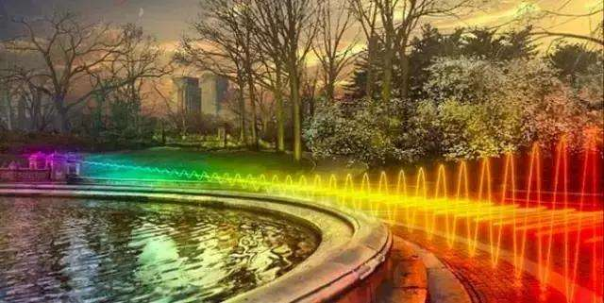
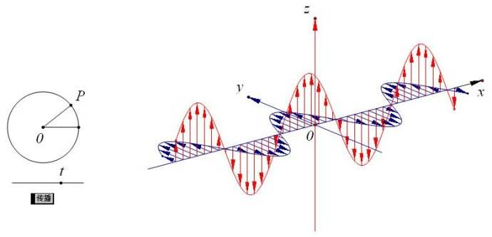
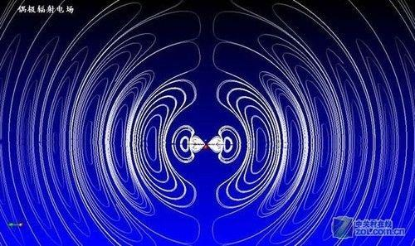
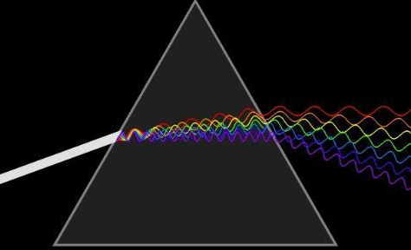
Common Illustration of EM Waves

Slide 17
Fields of Moving Charges
A good resource
http://phet.colorado.edu/sims/radiating-charge/radiating-charge_en.html
A static charge produces static electric field at the speed of light
When a charge is moving, the generated electric fields change accordingly
When the charge moves with acceleration, the generated electric fields exhibit oscillating natures, which will in turn generate magnetic fields and form electromagnetic fields

Slide 18
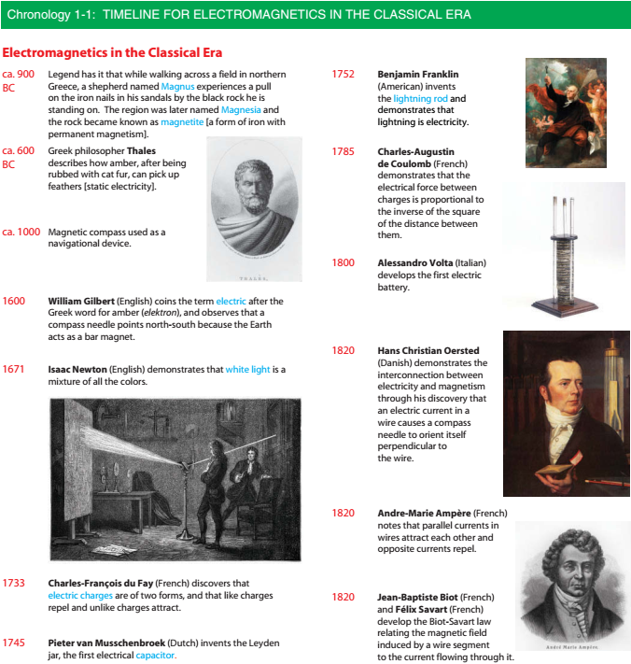

Slide 20
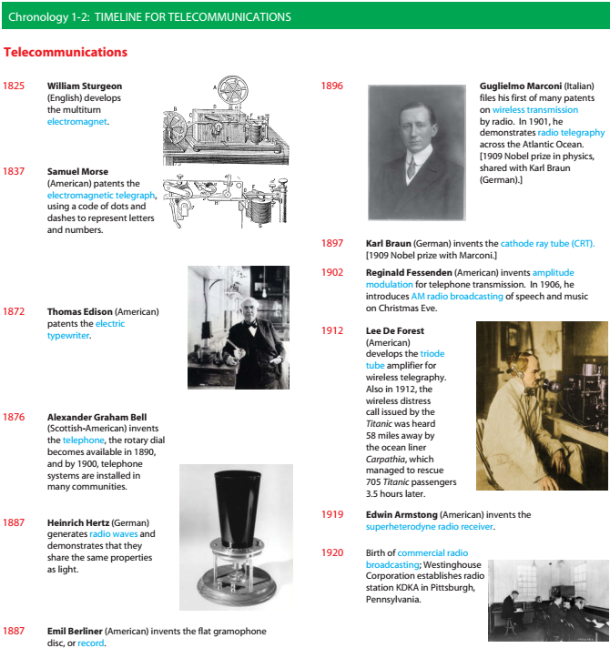

Slide 22
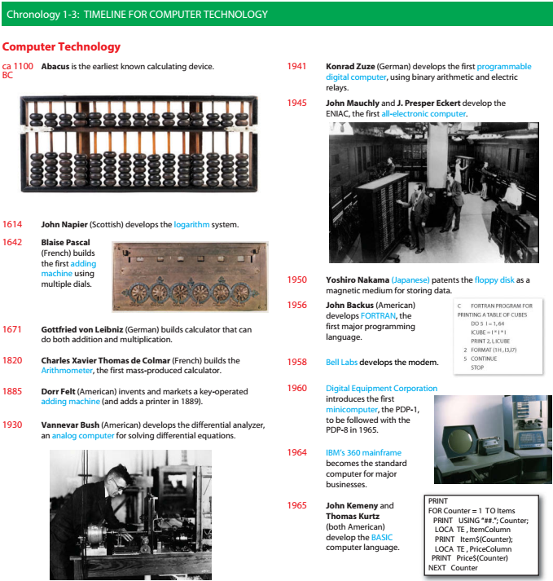

Slide 23
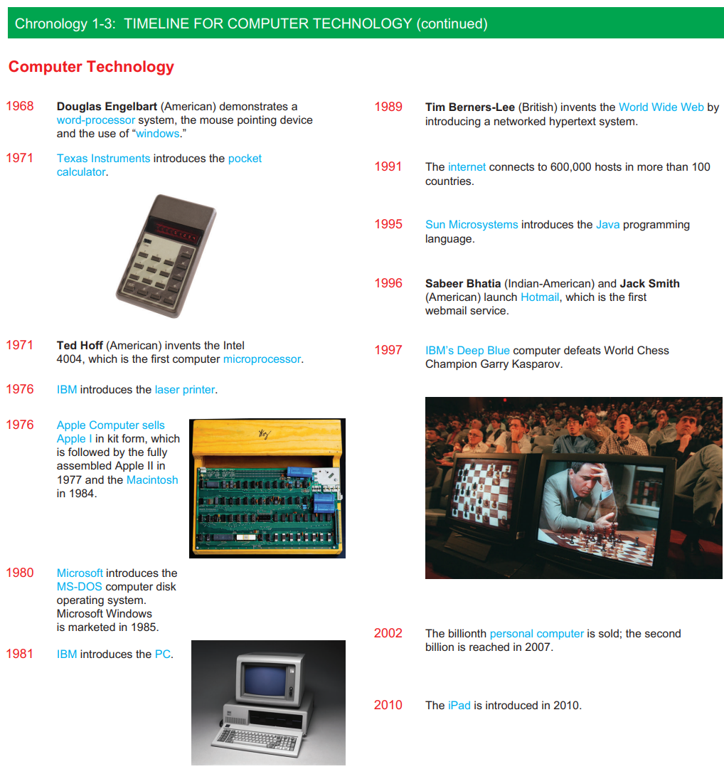

Slide 24
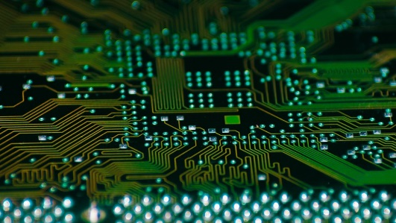
Examples of EM Applications
Integrated circuits

Slide 25
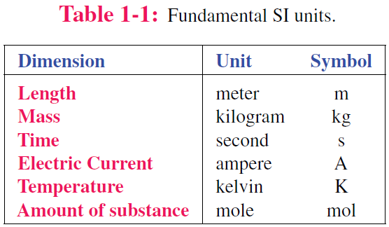
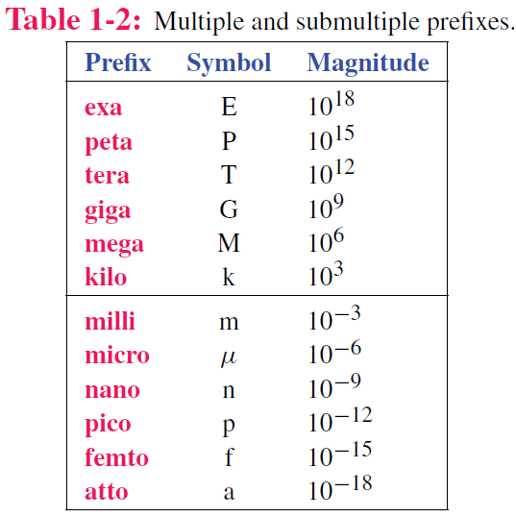
Dimensions and Units
Luminous intensity candela cd

Slide 26
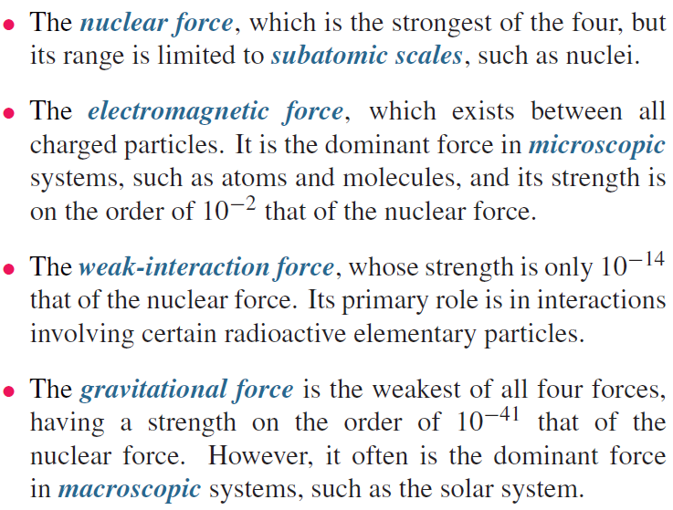
Fundamental Forces of Nature

Slide 27
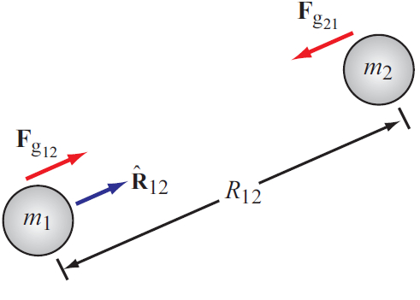
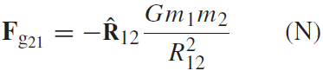
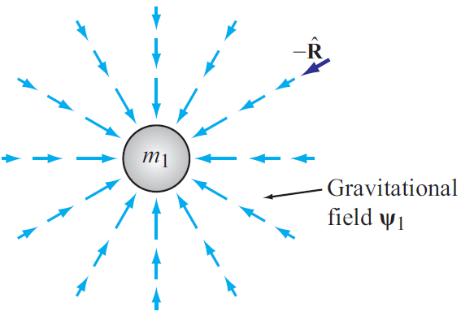
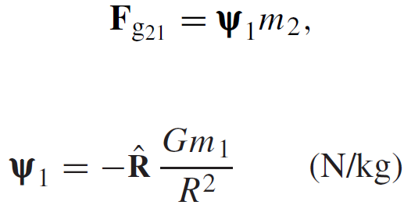
Gravitational Force
Force exerted on mass 2 by mass 1
Action at a distance
Gravitational FIELD induced by mass 1

Slide 28
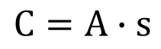
Charge: Electrical property of particles
Units: coulomb
Charge of an electron
One coulomb: amount of charge accumulated in one second by a current of one ampere.
e = 1.602 x 10⁻¹⁹ C
Charge conservation
The coulomb is named for a French physicist, Charles-Augustin de Coulomb (1736-1806), who was the first to measure accurately the forces exerted between electric charges.
Cannot create or destroy charge,
only transfer
$$C=A∙s$$

Slide 29
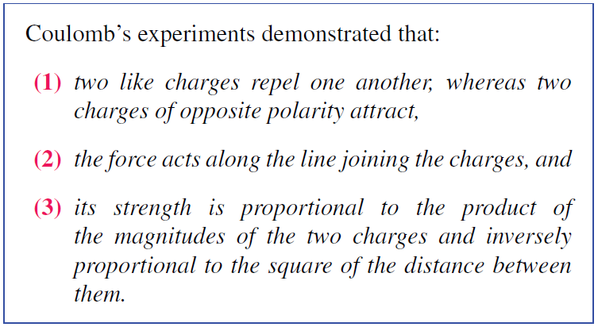
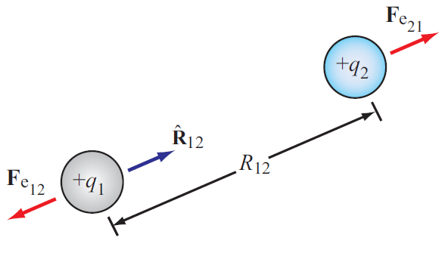
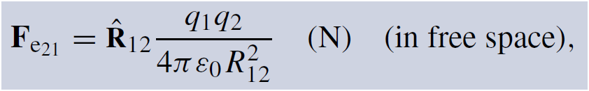
Electrical Force
Two differences between F_{g} and F_{e}
Force exerted on charge 2 by charge 1
Permittivity of free space
ε₀ = 8.854 × 10⁻¹² farad per meter (F/m)

Slide 30
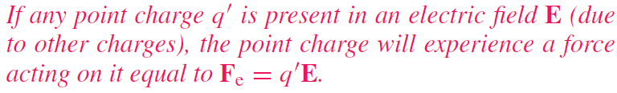
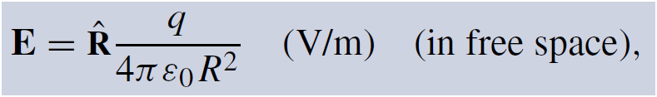
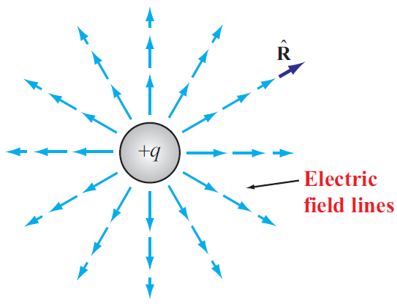
Electric Field In Free Space
Permittivity of free space

Slide 31
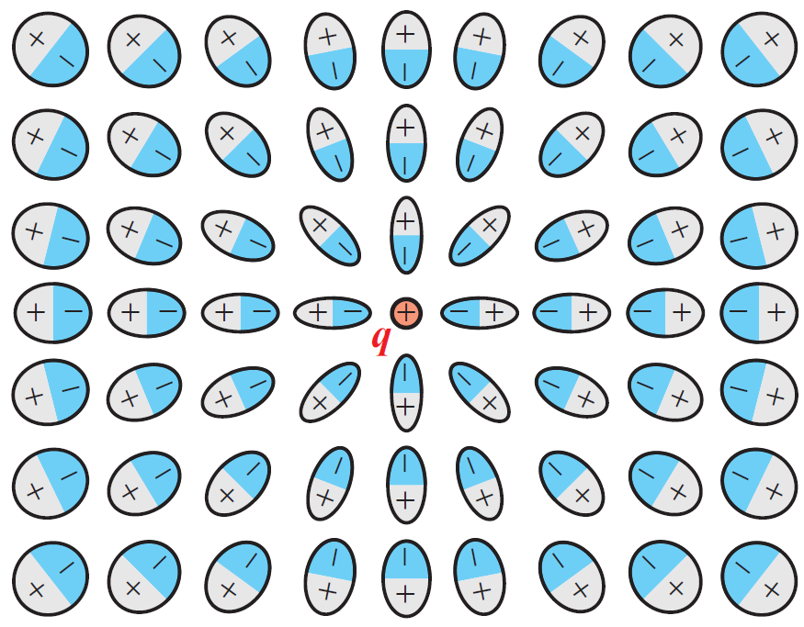
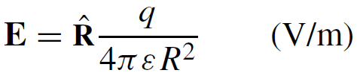
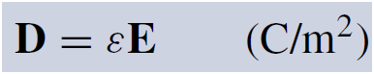
Electric Field Inside Dielectric Medium
Polarization of atoms changes electric field
New field can be accounted for by changing the permittivity
Permittivity of the material
Another quantity used in EM is the electric flux density D:
Electric dipole
The fields of dipoles tend to counteract the field due to the positive charge

Slide 32
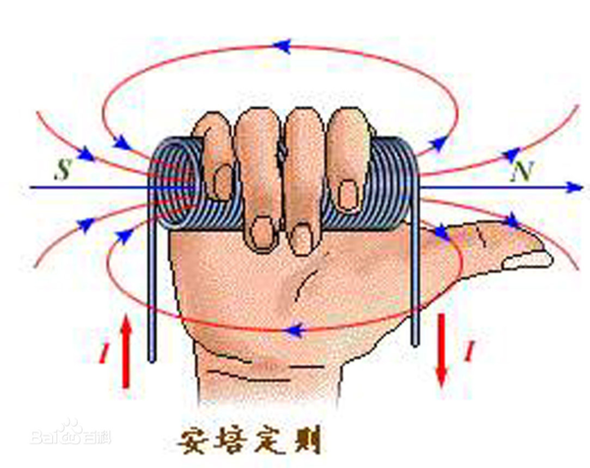
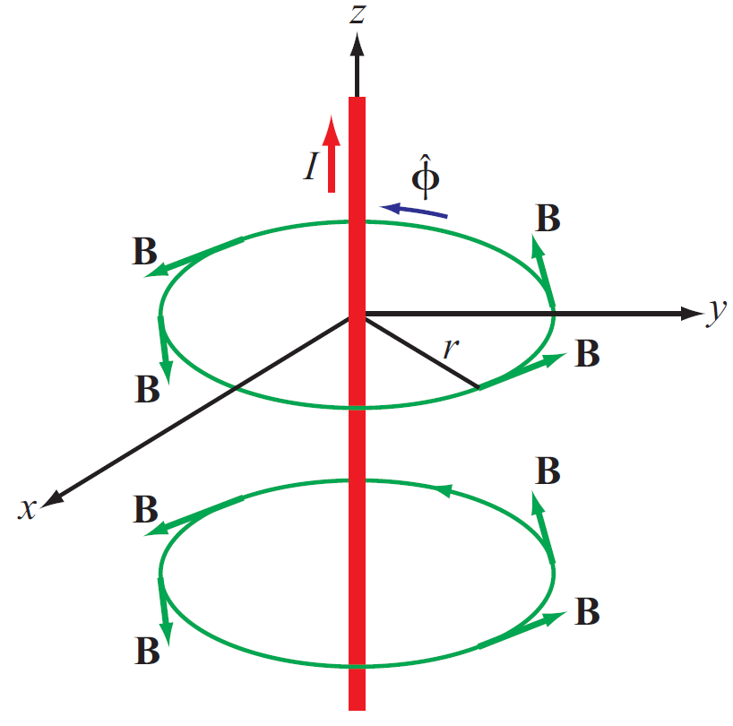
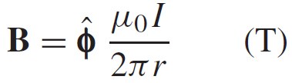
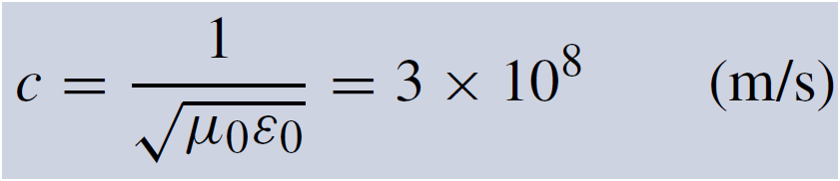
Magnetic Field In Free Space
Electric charges can be isolated, but magnetic poles always exist in pairs.
Magnetic field induced by a current in a long wire
Magnetic permeability of free space
Electric and magnetic fields are connected through the speed of light:

Slide 33
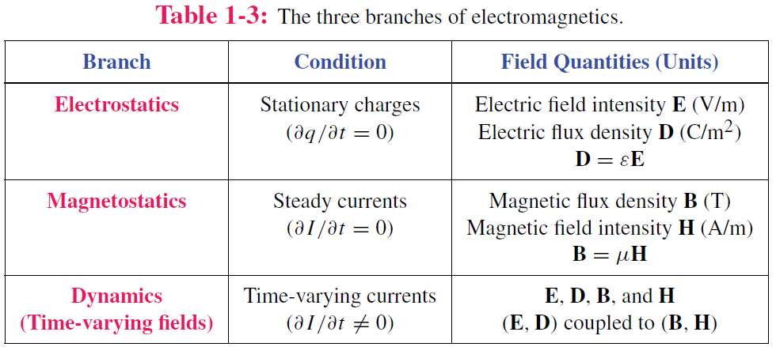
Static vs. Dynamic
Static conditions: charges are stationary or moving, but if moving, they do so at a constant velocity.
Under static conditions, electric and magnetic fields are independent, but under dynamic conditions, they become coupled.

Slide 34
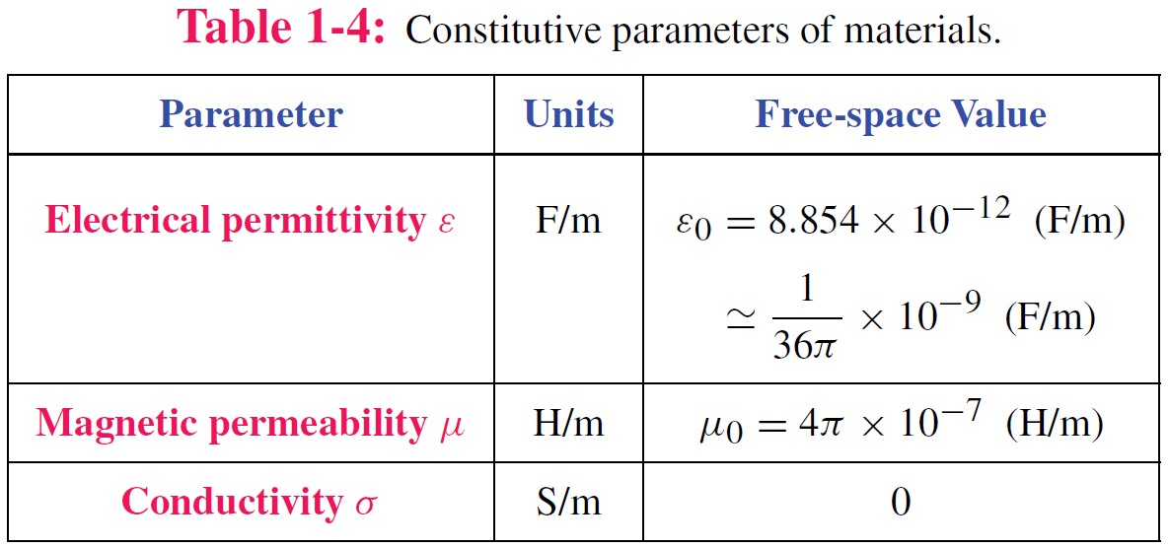
Material Properties

Slide 35
Traveling Waves
Waves carry energy
Waves have velocity
Many waves are linear: they do not affect the passage of other waves; they can pass right through them
Transient waves: caused by sudden disturbance
Continuous periodic waves: repetitive source

Slide 36
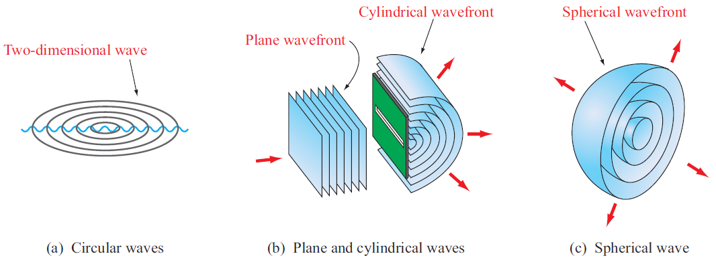
Types of Waves
Surface with equal phase

Slide 37
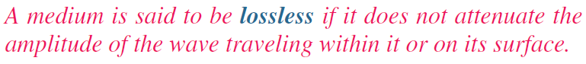
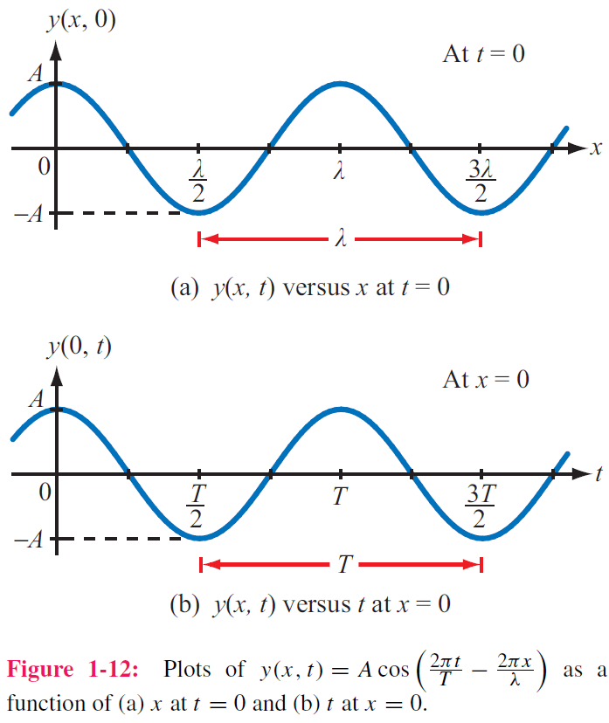
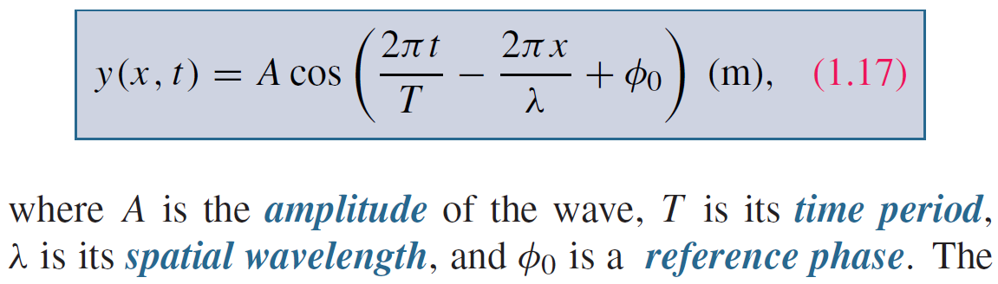
Sinusoidal Waves in Lossless Media
Take wave on water as an example
y = height of water surface
x = distance
Function of both time and space

Slide 38
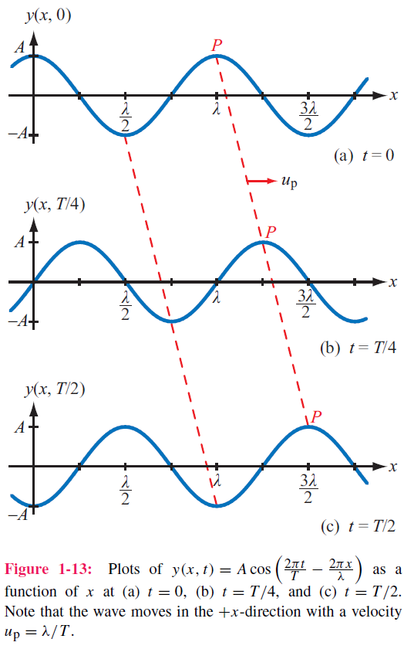
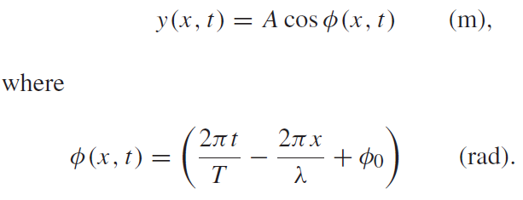
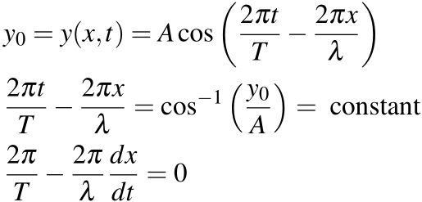
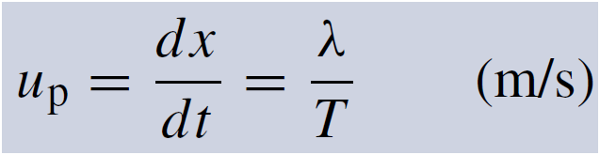
Phase velocity
If we select a fixed height y₀ and follow its progress, then

Slide 39
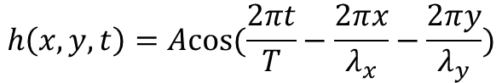
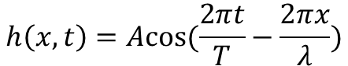
More Interpretation of Spatial Variables
The spatial variables in the cos function represent the directions in which the wave has propagation
$$h\left(x,t\right)=Acos(\frac{2πt}{T}−\frac{2πx}{λ})$$
$$h\left(x,y,t\right)=Acos(\frac{2πt}{T}−\frac{2πx}{λ_{x}}−\frac{2πy}{λ_{y}})$$

Slide 40
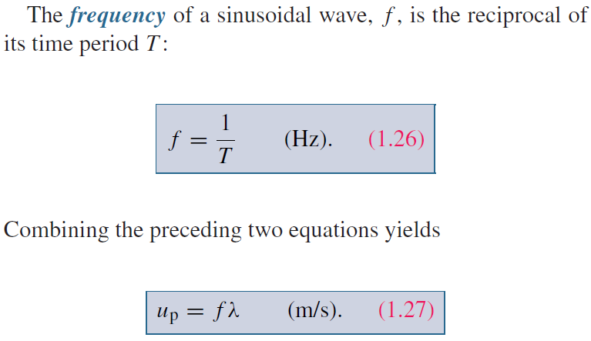
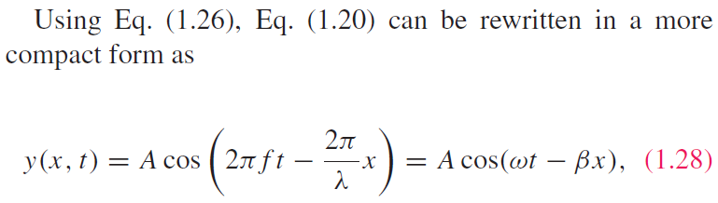
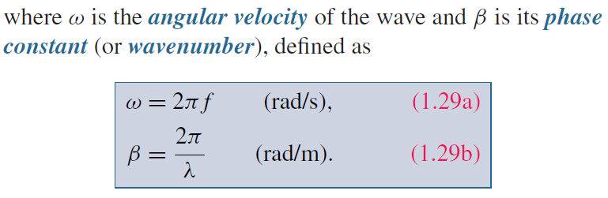
Wave Frequency and Period

Slide 41
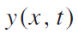
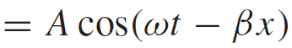
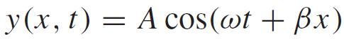
Direction of Wave Travel
Wave travelling in +x direction
As t increases, x has to increase to make (ωt − βx) constant
Wave travelling in ‒x direction
As t increases, x has to decrease to make (ωt + βx) constant
+x direction: if coefficients of t and x have opposite signs
‒x direction: if coefficients of t and x have same sign (both positive or both negative)

Slide 42
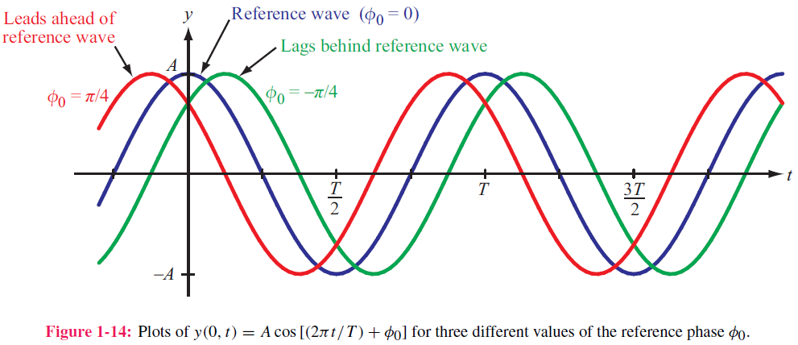
Phase Lead & Lag
t₀
t₀−T/8
t₀+T/8

Slide 43

Wave Travel in Lossy Media
Frequency does not change
Attenuation factor

Slide 44



Example 1-1: Sound Wave in Water
Given: sinusoidal sound wave traveling in
the positive x-direction in water
Wave amplitude is 10 N/m2, and p(x, t) was observed to be at its maximum value at t = 0 and x = 0.25 m. Also f=1 kHz, up=1.5 km/s.
Determine: p(x,t)
Solution:

Slide 45


Slide 46


The EM Spectrum

Slide 47


Slide 48

Complex Numbers
We will find it is useful to represent sinusoids as complex numbers
Rectangular coordinates
Polar coordinates
Relations based on Euler’s Identity

Slide 49

Relations for Complex Numbers
Learn how to perform these with your calculator/computer

Slide 50

Phasor Domain
1. The phasor-analysis technique transforms equations
from the time domain to the phasor domain.
2. Integro-differential equations get converted into
linear equations with no sinusoidal functions.
3. After solving for the desired variable--such as a particular voltage or current-- in the phasor domain, conversion back to the time domain
provides the same solution that would have been obtained had the original integro-differential equations been solved entirely in the time domain.

Slide 51


Phasor Domain
Phasor counterpart of $v(t)$
Phase is needed

Slide 52

Time and Phasor Domain
It is much easier to deal with exponentials in the phasor domain than sinusoidal relations in the time domain
Just need to track magnitude/phase, knowing that everything is at frequency ω

Slide 53

Phasor Relation for Resistors
Current through resistor
Time Domain
Frequency Domain
Time domain
Phasor Domain

Slide 54


Phasor Relation for Inductors
Time domain
Phasor Domain
Time Domain

Slide 55



Phasor Relation for Capacitors
Time domain
Phasor Domain

Slide 56

Example
Sine reference
Integral property
Cosine reference

Slide 57







ac Phasor Analysis: General Procedure

Slide 58
Example 1-4: RL Circuit
Cont.

Slide 59
Example 1-4: RL Circuit cont.

Slide 60

Travelling Waves in Phasor Domain

Slide 61

Summary

